Slide 1





CRUST PIZZA
CRUST PIZZA DATA ANALYSIS

Slide 2


CRUST PIZZA
ABOUT THE PROJECT
This project focuses on analyzing sales data from a pizza business to identify trends and insights. The database is designed to capture essential information about pizza types, orders, and sales. Key objectives include determining top-selling pizzas, understanding revenue contributions by category, identifying peak order times, and calculating cumulative revenue over time. The analysis helps inform business decisions such as menu optimization and marketing strategies.

Slide 3
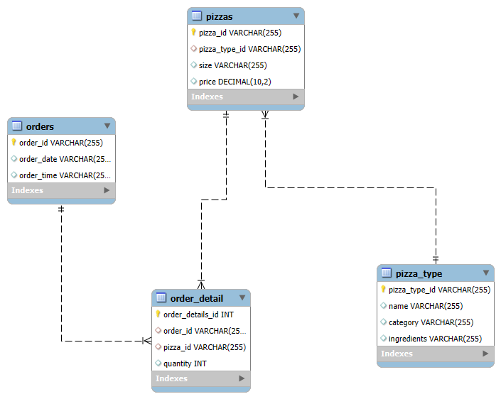
CRUST PIZZA
ER-DIAGRAM FOR CRUST PIZZA
Table Name | Description
pizza_type | Stores types of pizzas with their categories and ingredients
orders | Records order IDs, dates, and times
pizzas | Contains pizza details (size, price, linked to pizza_type)
order_detail | Captures pizza quantities per order (linked to pizzas and orders)

Slide 4

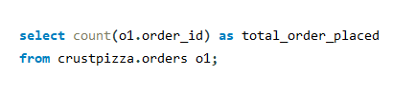
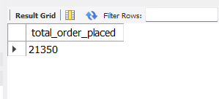
CRUST PIZZA
1. RETRIEVE THE TOTAL NUMBER OF ORDERS PLACED.

Slide 5
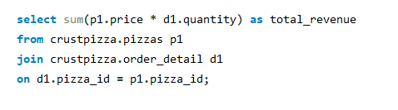

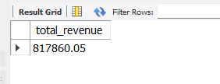
CRUST PIZZA
2. CALCULATE THE TOTAL REVENUE GENERATED FROM PIZZA SALES.

Slide 6
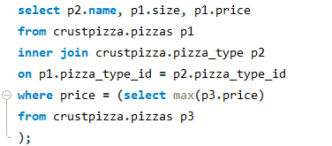
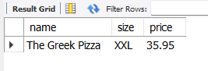
CRUST PIZZA
3. IDENTIFY THE HIGHEST-PRICED PIZZA.

Slide 7
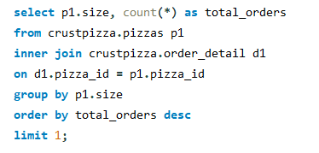
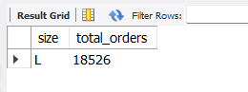
CRUST PIZZA
4. IDENTIFY THE MOST COMMON PIZZA SIZE ORDERED.

Slide 8
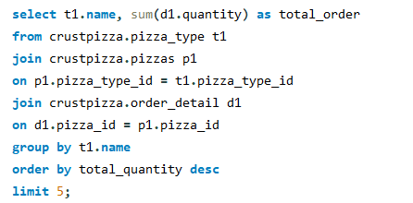
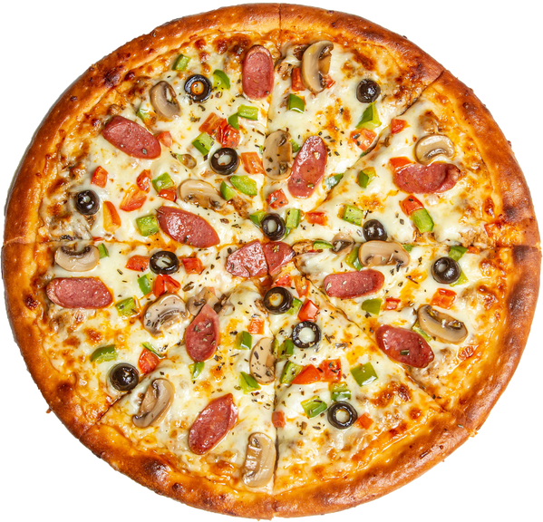
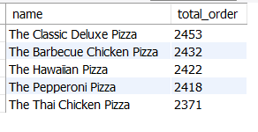
CRUST PIZZA
5. LIST THE TOP 5 MOST ORDERED PIZZA TYPES ALONG WITH THEIR QUANTITIES.

Slide 9
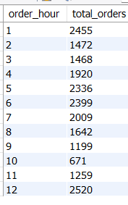
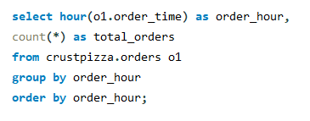
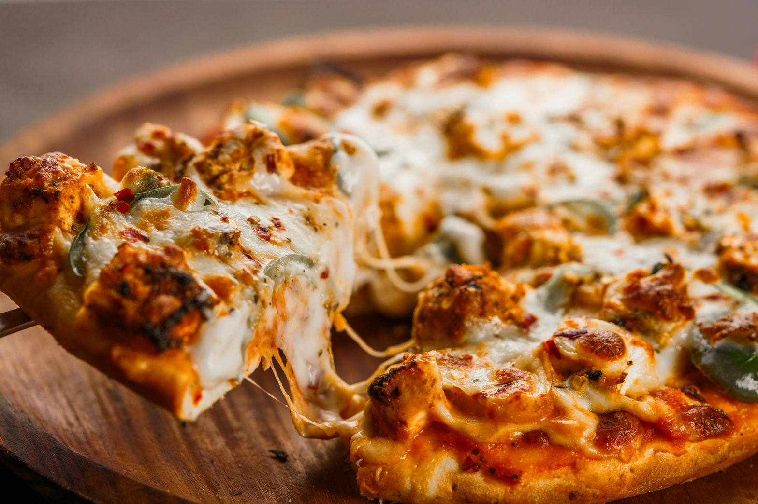
CRUST PIZZA
6. DETERMINE THE DISTRIBUTION OF ORDERS BY HOUR OF THE DAY.

Slide 10

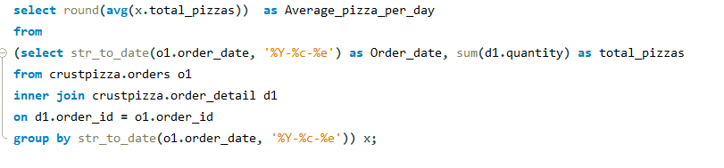
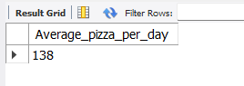
CRUST PIZZA
7. CALCULATE THE AVERAGE NUMBER OF PIZZAS ORDERED PER DAY.

Slide 11
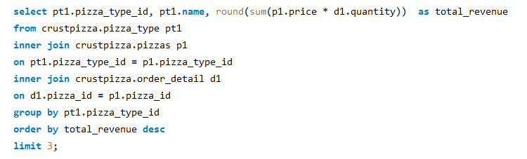
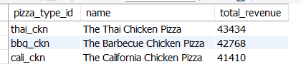
CRUST PIZZA
8. DETERMINE THE TOP 3 MOST ORDERED PIZZA TYPES BASED ON REVENUE.

Slide 12
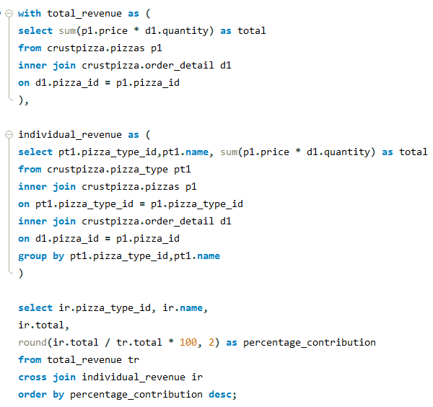
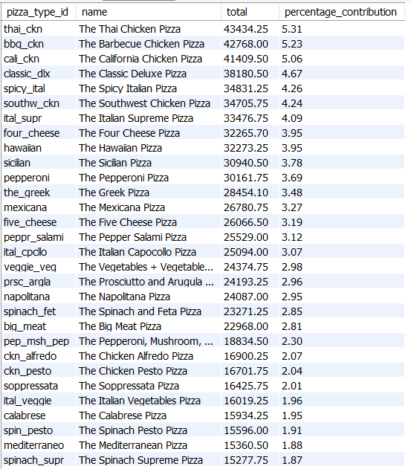
CRUST PIZZA
9. CALCULATE THE PERCENTAGE CONTRIBUTION OF EACH PIZZA TYPE TO TOTAL REVENUE.

Slide 13
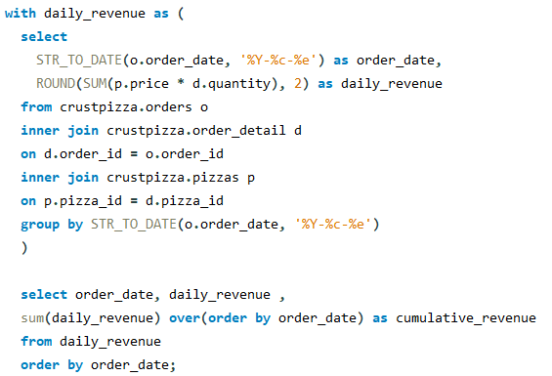
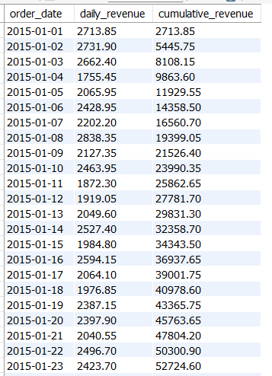
CRUST PIZZA
10. ANALYZE THE CUMULATIVE REVENUE GENERATED OVER TIME.

Slide 14
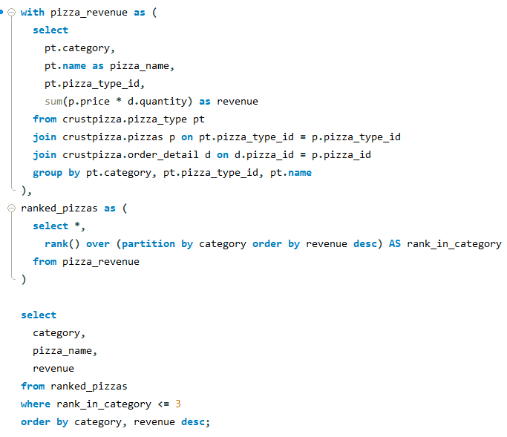
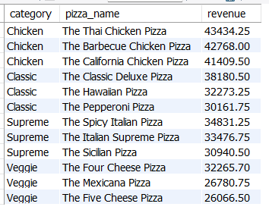
CRUST PIZZA
11. DETERMINE THE TOP 3 MOST ORDERED PIZZA TYPES BASED ON REVENUE FOR EACH PIZZA CATEGORY.

Slide 15



CRUST PIZZA
THANK YOU
0410663164
LAWATI.NIROJ@GMAIL.COM
FISHER ACT 2611

